Slide 1
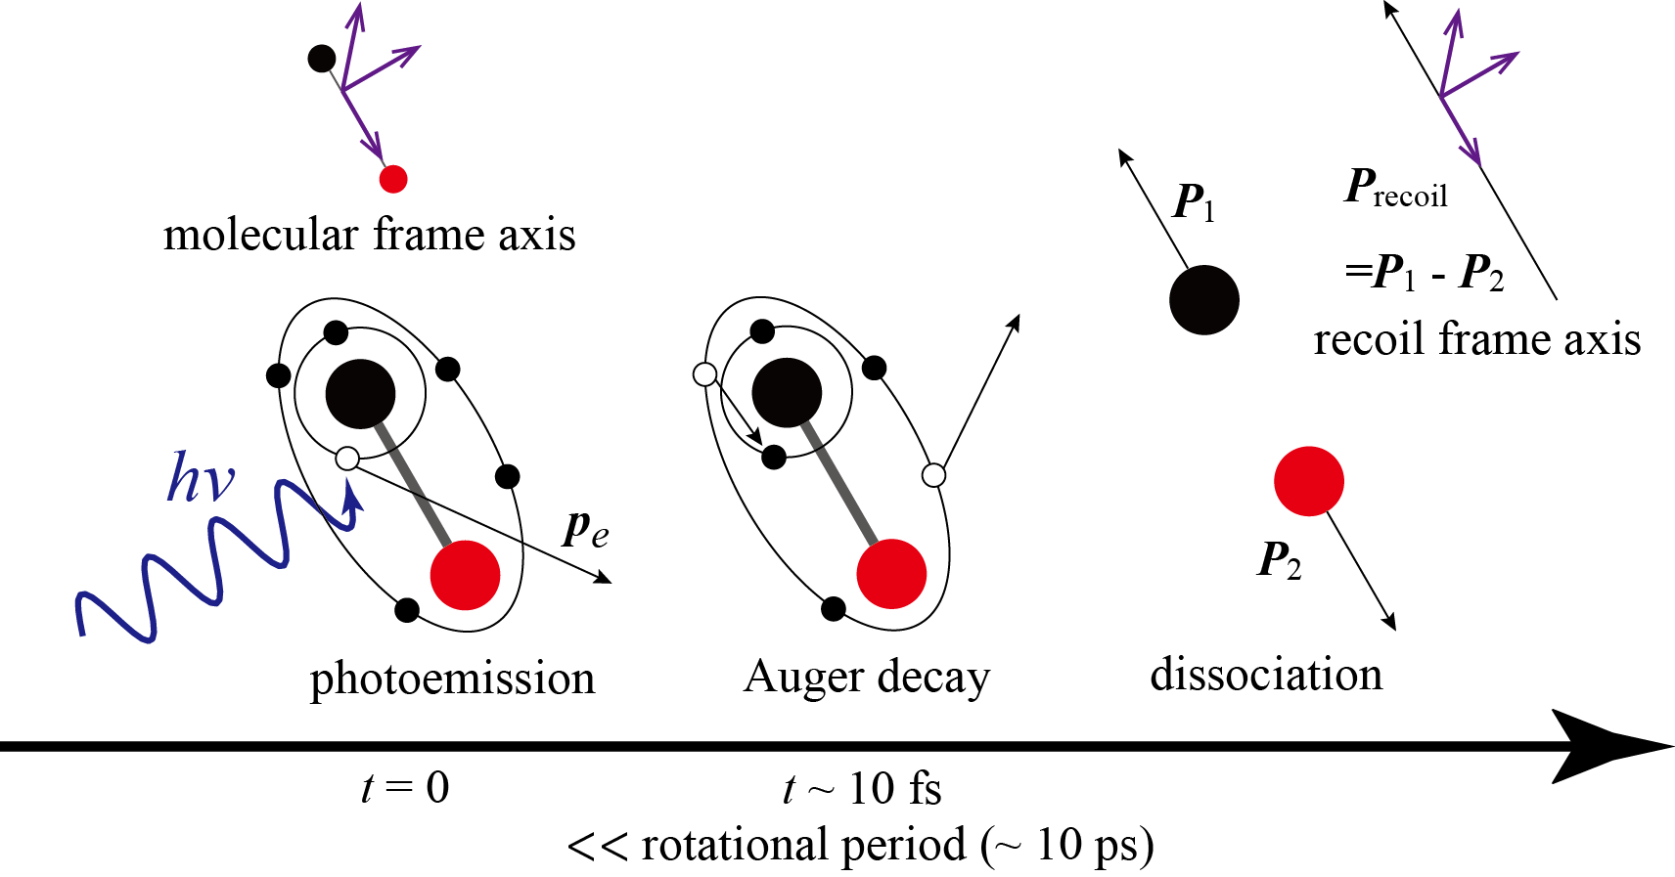
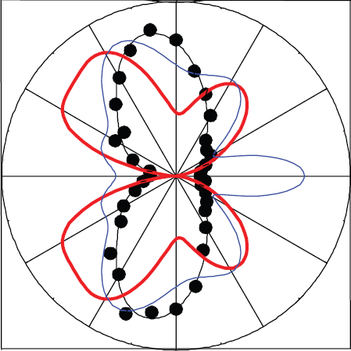
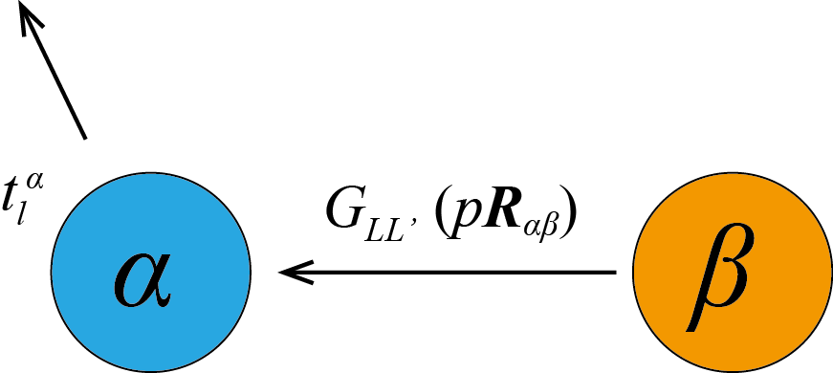
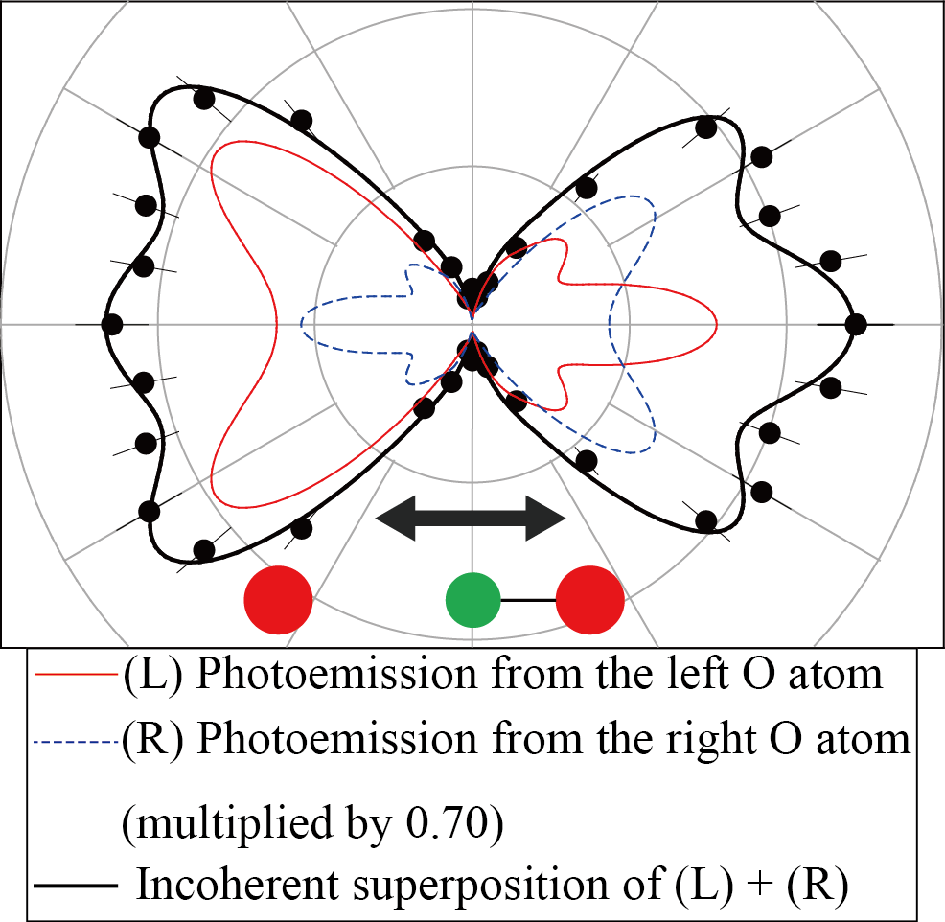
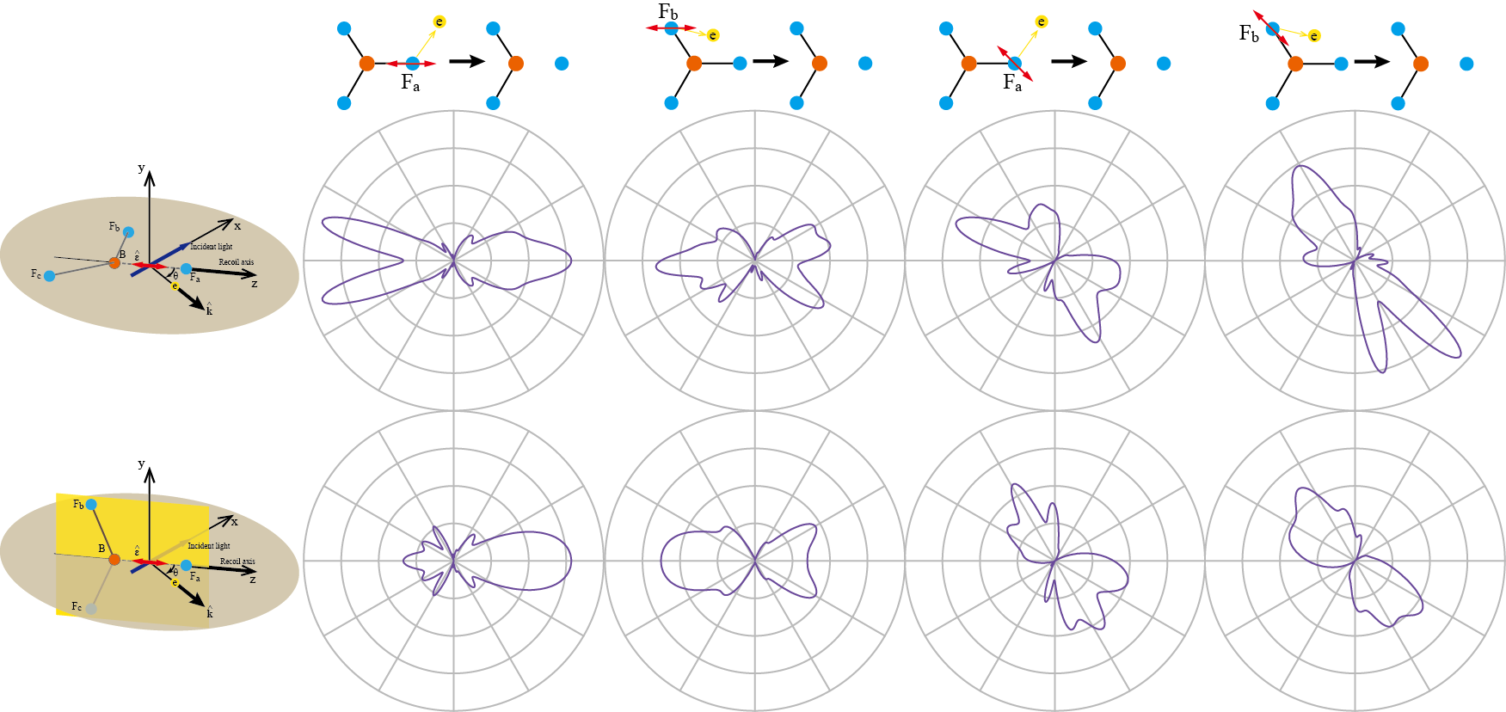
F 1s photoelectron angular distributions detected in coincidence with the BF₂⁺-F⁺ ions of BF₃ molecules: fragmentation – site dependence of them
Shota Tsuru¹, Takashi Fujikawa¹, Tomoya Mizuno² and Akira Yagishita²
¹Graduate School of Advanced Integration Science, Chiba University, Chiba 263-8522, Japan
²Institute of Materials Structure Science, KEK, Tsukuba, Ibaraki 305-0801 Japan
Molecular-frame photoelectron angular distributions (MFPADs)
Two roles of the fragment ion pair detection
1. To record the lab frame location of molecular axis
2. To select a specific dissociation channel
(The case of polyatomic molecules)
MFPADs are rich source of information on photoionization dynamics, and feasible by photoelectron-photoion coincidence techniques.
MFPADs also reveal dissociation dynamics.
[1]. A. Yagishita, K. Hosaka and J. Adachi, J. Electron Spectrosc. Relat. Phen.,142, 295 (2005)
[2]. K. L. Reid, Mol. Phys. 110, 131 (2012)
F 1s RFPADs for the BF₂⁺-F⁺ fragment ion pair
Process to obtain MFPADs of diatomic molecules [1][2]
Multiple Scattering X-ray Photoelectron Diffraction (XPD) theory
K.E. = 4.6 eV
$${\left\langle {f_{p}}^{−} | ∆ | φ_{c}\right\rangle }_{∞}=\sum_{α}{e^{−ip∙R_{αA}}}\sum_{LL^{′}}{Y_{L^{′}}\left(\hat{p}\right){\left[{\left(1−X\right)}^{−1}\right]}_{L^{′}L}^{αA}M_{LL_{c}}}$$
$${\left(1−X\right)}^{−1}=1+X+X^{2}+⋯$$
$$X_{LL^{′}}^{αβ}=\left(1−δ^{αβ}\right)t_{l}^{α}\left(p\right)G_{LL^{′}}\left(pR_{αβ}\right)$$
Experimental
Only B-F with core hole breaks.
BF₃ has three equivalent B-F bonds.
The molecular orientation cannot be defined by the BF₂⁺-F⁺ recoil axis.
Equally breaks.
The bond breaking probabilities are not equal[3], but only B-F with core hole breaks?
This theory well describes photoelectron scattering within a molecule in the high energy off-resonance region[4].
Theoretical model and comparison between experimental and XPD theoretical results
[3].T. Mizuno et al, J. Chem. Phys. 136, 074305 (2012)
[4]. H. Shinotsuka, H. Arai, T. Fujikawa, Phys. Rev. B 77, 085404 (2008)
$$I\left(\hat{k}\right)\sim {\left|\left\langle ψ_{k}^{\left(−\right)} | z\left(x\right) | ψ_{1s}^{F_{a}}\right\rangle \right|}^{2}+P^{F_{b}}{\left|\left\langle ψ_{k}^{\left(−\right)} | z\left(x\right) | ψ_{1s}^{F_{b}}\right\rangle \right|}^{2}+P^{F_{c}}{\left|\left\langle ψ_{k}^{\left(−\right)} | z\left(x\right) | ψ_{1s}^{F_{c}}\right\rangle \right|}^{2}$$
The RFPADs are given by the incoherent superposition of the ones of 3 different channels [5].
Reference to O 1s PAD in O⁺-CO⁺ molecular frame from CO₂
K.E. = 120 eV
K.E. = 142 eV
Better agreement between experimental and theoretical results at P^{Fb} = P^{Fc} = 0.57 than P^{Fb} = P^{Fc} = 0 indicates that not only B-F with core hole but also without breaks.
Discussion
<The possible causes of the difference in relative bond breaking probability of B-F of BF₃ and C-O of CO₂>
1. The bond length
B-F of BF₃: 1.3070Å
C-O of CO₂: 1.1600Å
2. The numbers of electrons in
bonding valence orbitals
BF₃: 6, CO₂: 8
3. B-F bond is more ionic than C-O
bond.
(a) BF₃ // ZX-plane
(b) BF₃ ⊥ ZX-plane
[5]. S. Tsuru, M. Kazama, T. Fujikawa, J. Adachi, T. Mizuno and A. Yagishita, Chem. Phys. Lett. 608, 152 (2014)
No scatterer exists in the direction of polarization vector if an electron is emitted from F_{b}(F_{c}) except the case (a).
Summary
The B-F bond with the F 1s hole breaks preferentially, however the bond breaking of B-F bonds without the F 1s hole also contributes to the F 1s RFPADs from BF₂⁺-F⁺.
Many fine structures of RFPADs are washed out by the rotation around the recoil axis.
Step towards quantitative determination of site-selectivity of chemical bond cleavage by experimental MFPADs and the simple model based on the multiple scattering XPD theory.

